Slide 1
More Background and Colors
Module 11

Slide 2
Backgrounds

Slide 3

CSS Backgrounds
In this chapter we’ll learn how to add multiple background images to a single element
We’ll also learn about the background-size, background-origin, and background-clip properties

Slide 4
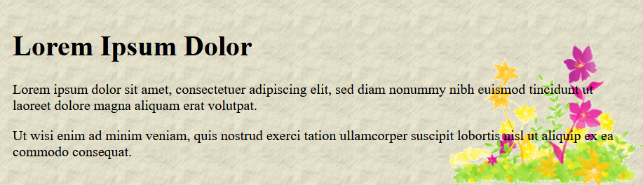
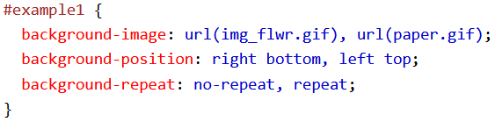
Multiple Backgrounds
Using the background-image property, we can add multiple background images to our elements
We separate the background images by commas and the images get stacked on top of each other
The first background image goes on top

Slide 5
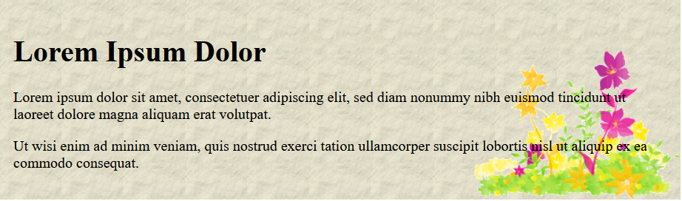
Multiple Background Images
Multiple background images can be specified using the background shorthand property as well

Slide 6
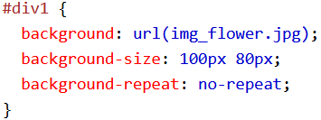

Background Size
The background-size property allows you to set the size of background images
We can specify the size in lengths, percentages, or using contain or cover

Slide 7
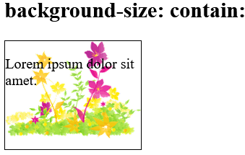
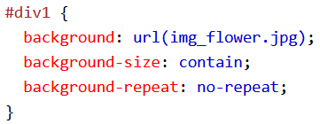
Background Size - Contain
The contain value scales the background image to be as large as possible while staying within the content area and maintaining its aspect ratio
Depending on the shape/size of the background image and positioning area, some of the background image may not show

Slide 8
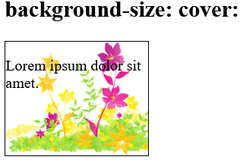
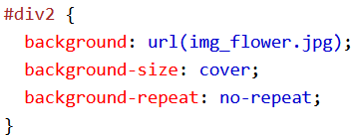
Background Size - Cover
The cover value scales the background image so that the content is completely covered by the background image.
The image may be stretched or squished to fit the background

Slide 9
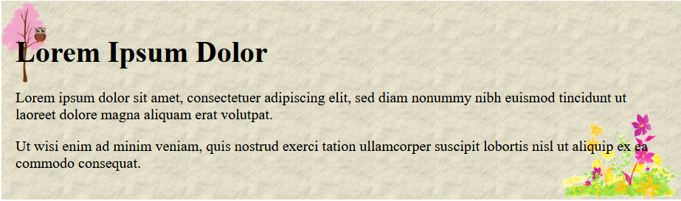
Define Sizes of Multiple Background Images
The background-size property also accepts multiple values for background size (using a comma-separated list), when working with multiple backgrounds

Slide 10

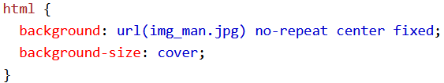
Full Size Background Image
Now we want to have a background image on a website that always covers the entire browser window
We want the background image to: fill the entire page with the image (no white space), scale as needed, center itself on screen, and not use scrollbars
We can do it like this:

Slide 11

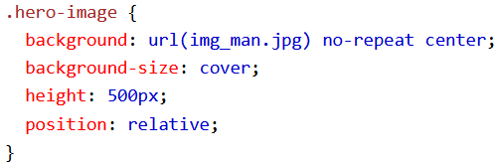
Hero Image
A hero image is a large image with text displayed over it
We can create a hero image like this:

Slide 12
The background-origin Property
The background-origin property specifies where the background-image is positioned
The background-origin property takes three values: border-box, padding-box (default), and content-box

Slide 13
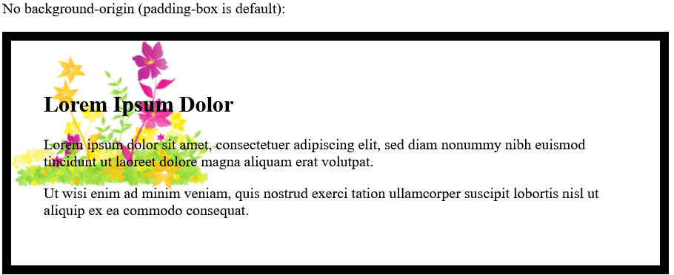
The background-origin Property
padding-box (default): the background image starts from the upper left corner of the padding edge

Slide 14
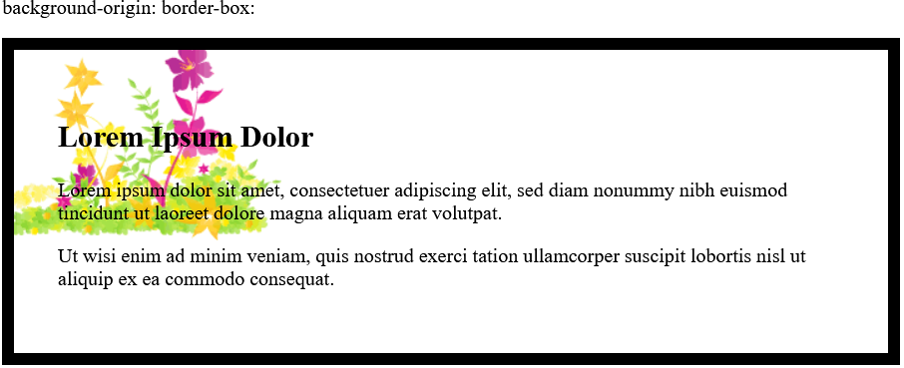
The background-origin Property
border-box: the background image starts from the upper left corner of the border

Slide 15
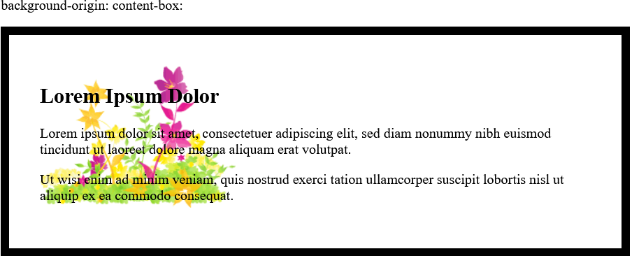
The background-origin Property
content-box: the background image starts from the upper left corner of the content

Slide 16
The background-clip Property
The background-clip property specifies the painting area of the background
background-clip takes three different value: border-box (default), padding-box, and content-box

Slide 17
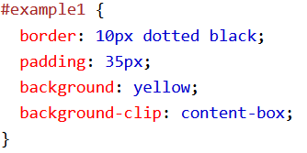
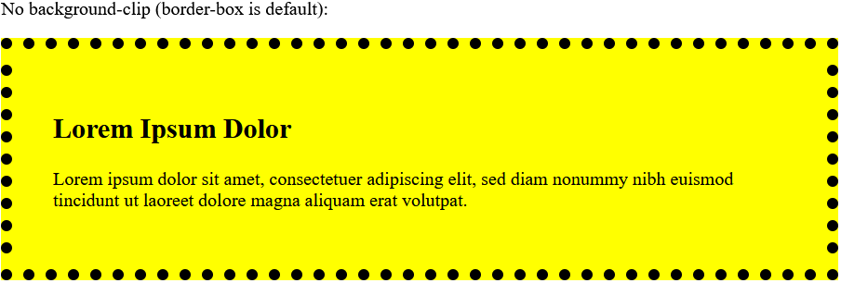
The background-clip Property
border-box (default): the background is painted to the outside edge of the border

Slide 18
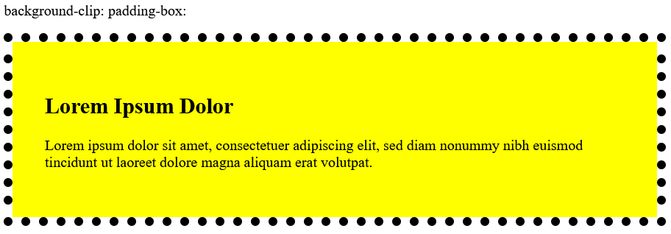
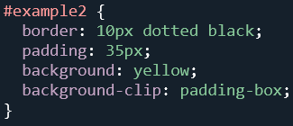
The background-clip Property
padding-box: the background is painted to the outside edge of the padding

Slide 19
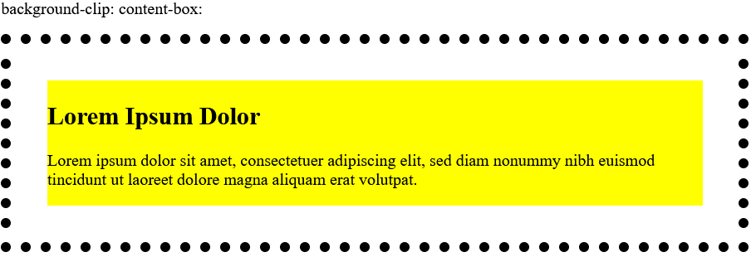
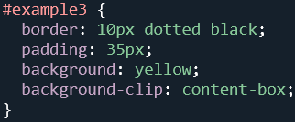
The background-clip Property
content-box: the background is painted within the content box

Slide 20
Colors

Slide 21
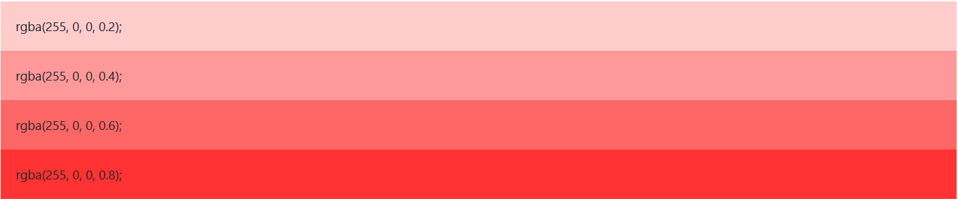
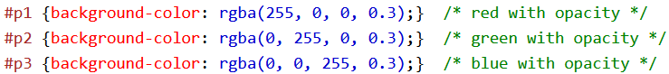
RGBA Colors
RGBA colors are an extension of RGB colors with an added alpha channel – which specifies the opacity for the color
An RGBA color value is specified with rgba(redValue, greenValue, blueValue, alphaValue)
The alpha value is a number between 0 and 1

Slide 22
HSL Colors
HSL stands for Hue, Saturation, Lightness
An HSL color value is specified with: hsl(hueValue, saturationValue, lightnessValue)

Slide 23
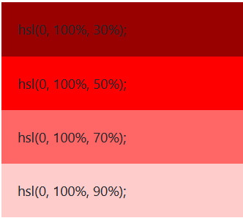
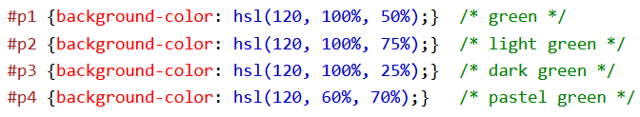
HSL Colors
Hue is a degree on the color wheel (0 – 360) where 0 is red, 120 is green, and 240 is blue
Saturation is a percentage value where 100% if the full color
Lightness is a percentage value where 0% is dark (black) and 100% is light (white)

Slide 24
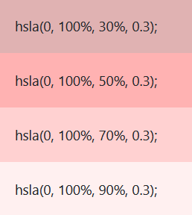
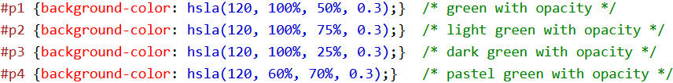
HSLA Colors
HSLA colors are an extension of HSL color values with an added alpha channel – that specifies opacity
An HSLA color is specified with hsla(hueValue, saturationValue, lightnessValue, alphaValue)
The alpha value is a number between 0 (fully transparent) and 1 (fully opaque)

Slide 25
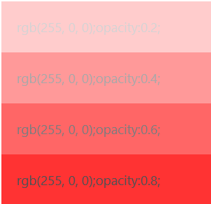
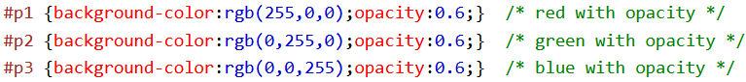
Opacity
The opacity property sets the opacity for the entire element (both the background color and the font color)
The opacity property must be a number between 0.0 (fully transparent) and 1.0 (fully opaque)

Slide 26
Gradients

Slide 27
CSS Gradients
Gradients let you display smooth transitions between 2 or more colors
There are several kinds of gradients:
Linear Gradients (goes down/up/left/right/diagonally)
Radial Gradients (defined by their center)
Conic Gradients (transition from one color to another around circumference of a circle)

Slide 28
Linear Gradients
Linear gradients require us to define at least 2 color stops (the colors we want to transition between)
We can also set a starting point or angel for the gradient

Slide 29
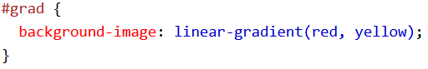

Linear Gradients
Direction: Top to Bottom (Default)

Slide 30
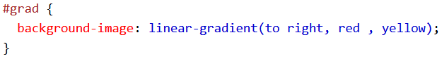

Linear Gradients
Direction: Left to Right

Slide 31
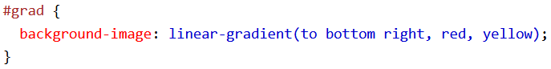

Linear Gradients
Direction: Diagonal
We can create a gradient in a diagonal line by specifying a direction using either keywords or a degree

Slide 32
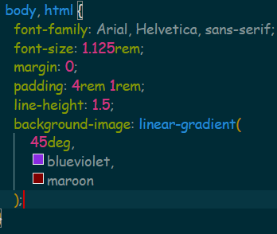

Linear Gradients
Direction: Diagonal (Degree)

Slide 33
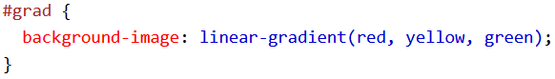

Using Multiple Color Stops

Slide 34
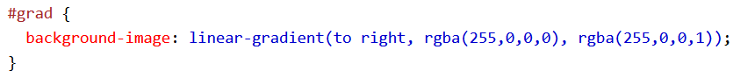

Using Transparency
We can combine gradients with RGBAs and HSLAs to create fading effects
To create this fade transition, we can use the same RGBA with different alpha values

Slide 35
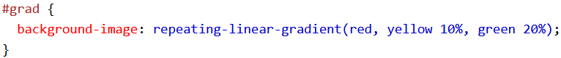
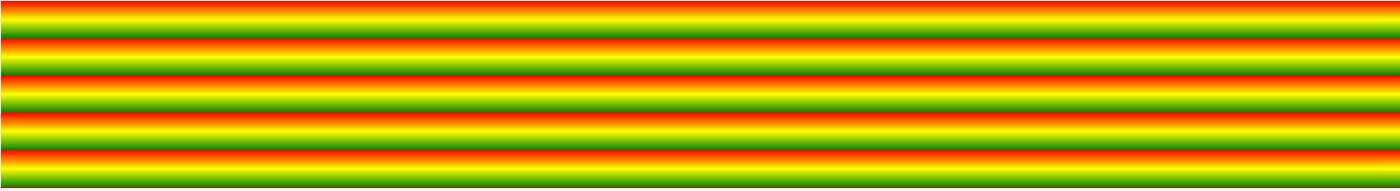
Repeating Linear Gradients
We can repeat linear gradients using the value repeating-linear-gradient() with gradient values

Slide 36
Radial Gradients
Radial Gradients are defined by their center and must have at least 2 color stops

Slide 37
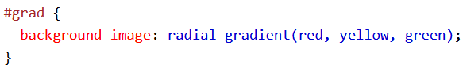

Radial Gradients
By default, shape is an ellipse, size is farthest-corner, and position is center.
Evenly Spaced Color Stops (Default)

Slide 38
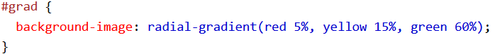

Radial Gradient
Differently Spaced Color Stops

Slide 39

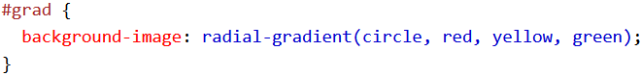
Set Shape
The shape parameter defines the shape
It can take the value circle or ellipse (default)

Slide 40
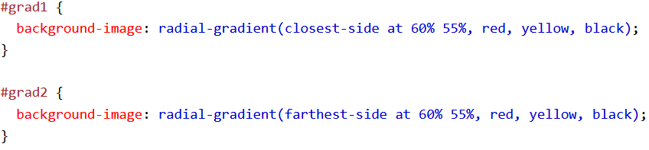
Use Different Size Keywords
The size parameter defines the size of the gradient
It can take 4 values: closest-side, farthest-side, closest-corner, farthest-corner

Slide 41
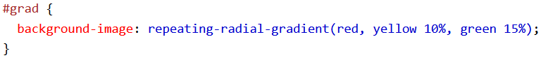
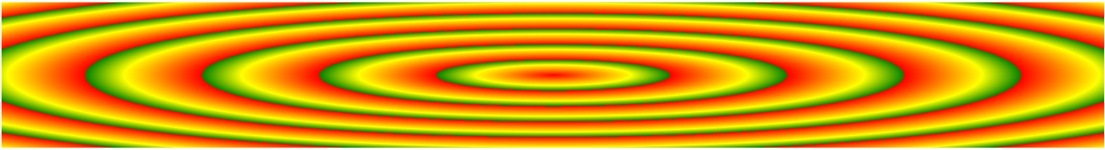
Repeating a Radial-Gradient
The repeating-radial-gradient() function is used to repeat radial gradients

